Slide 1


Slide 2
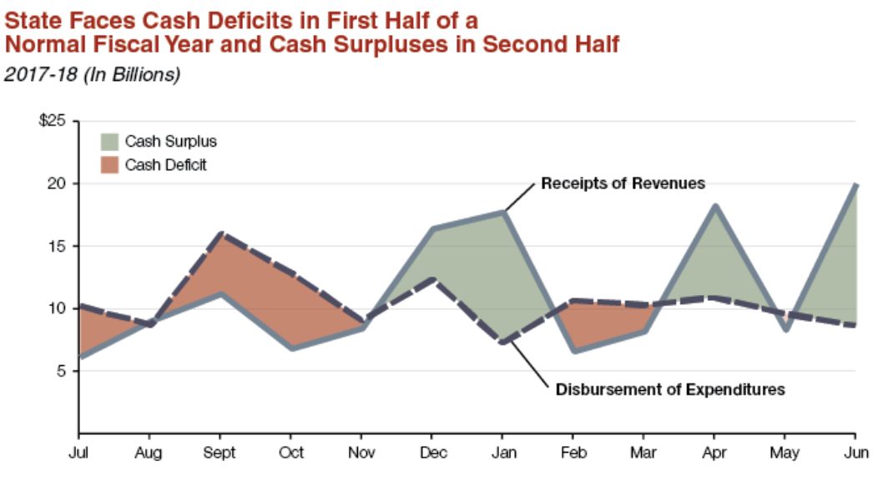

Slide 3
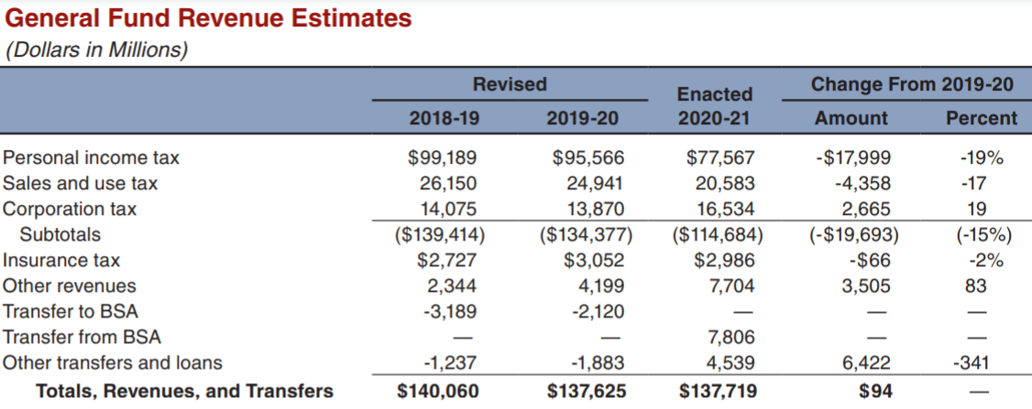

Slide 4
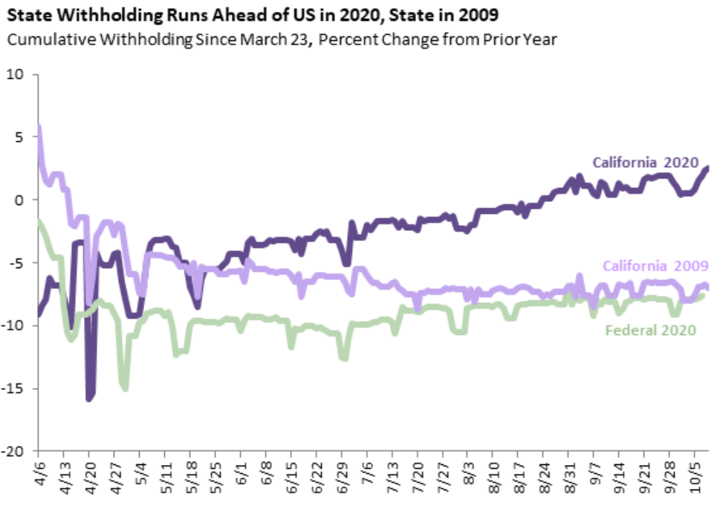

Slide 5
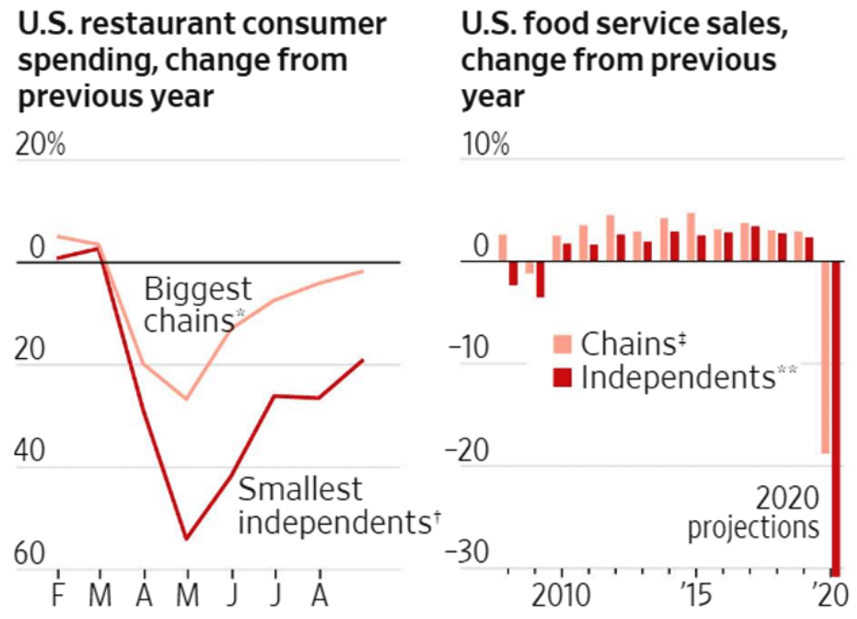

Slide 6
Highest & Lowest Population Growth
Enterprise, Nevada, experienced the highest population growth, at 8.14 percent.
East Los Angeles, California, experienced the highest population decrease, at 2.06 percent.

Slide 7
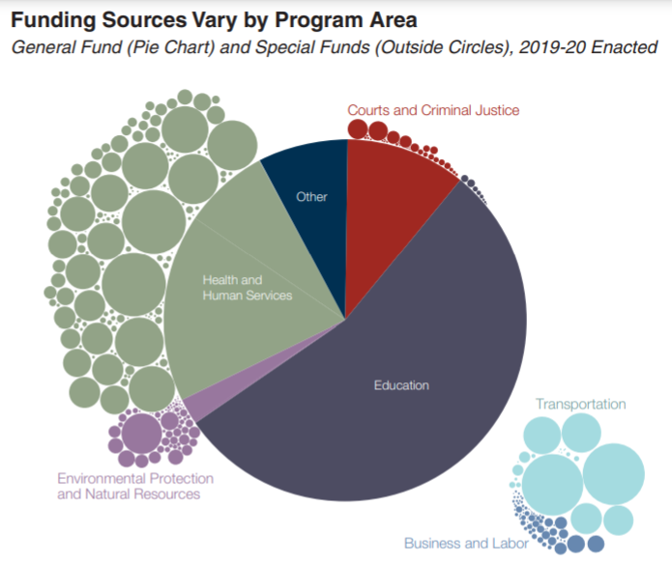

Slide 8
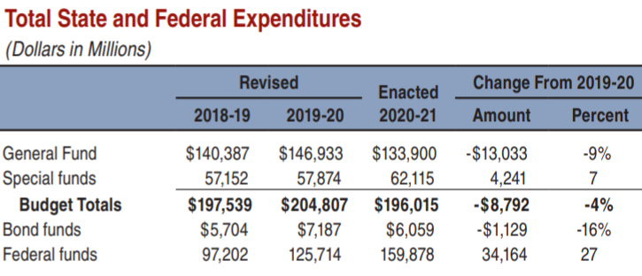

Slide 9
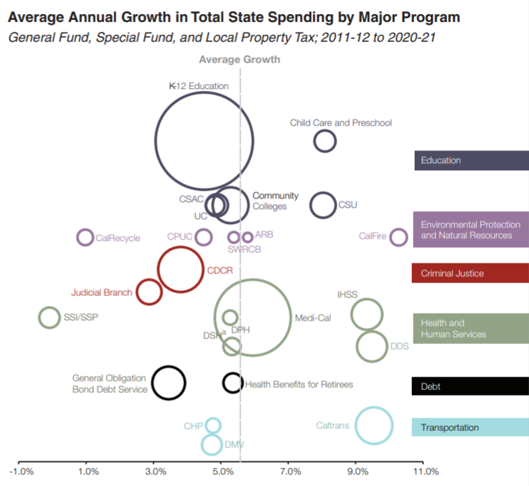

Slide 10
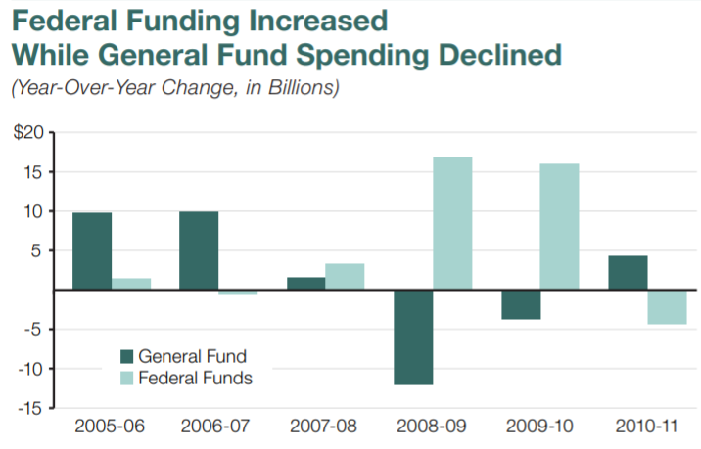

Slide 11
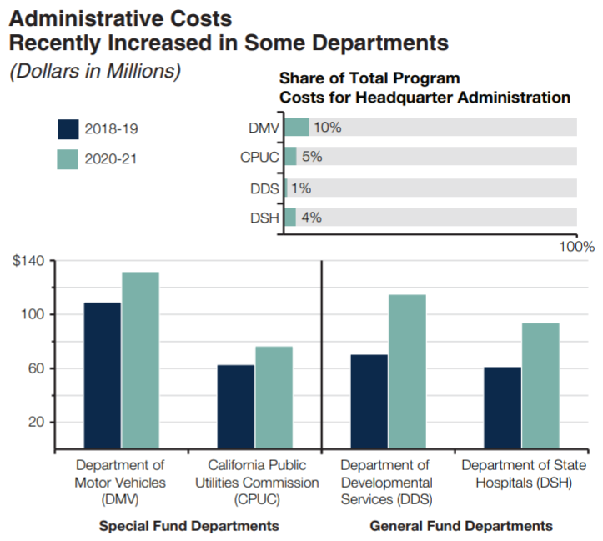

Slide 12
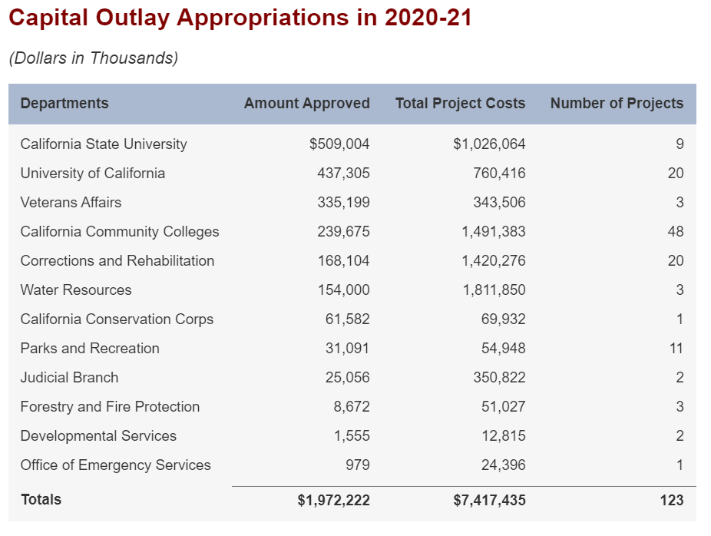

Slide 13
Capital Outlay Down -47%
Legislature approved $2 billion for 123 capital outlay projects in 2020-21. This is a decrease of $ 1.5 billion (43 percent) compared to the revised level of spending in 2019-20. The decrease is mainly due to the reduction in capital outlay projects included in the budget act as a result of the state’s fiscal condition.

Slide 14
Resources and Environmental Protection
Down -29%
The budget package provides a total of $10.9 billion from various fund sources—the General Fund, bond funds, and various special funds—for programs administered by the California Natural Resources and Environmental Protection Agencies. This is a net decrease of $4.4 billion (29 percent) compared to 2019‑20 estimated expenditures

Slide 15
